Slide 1
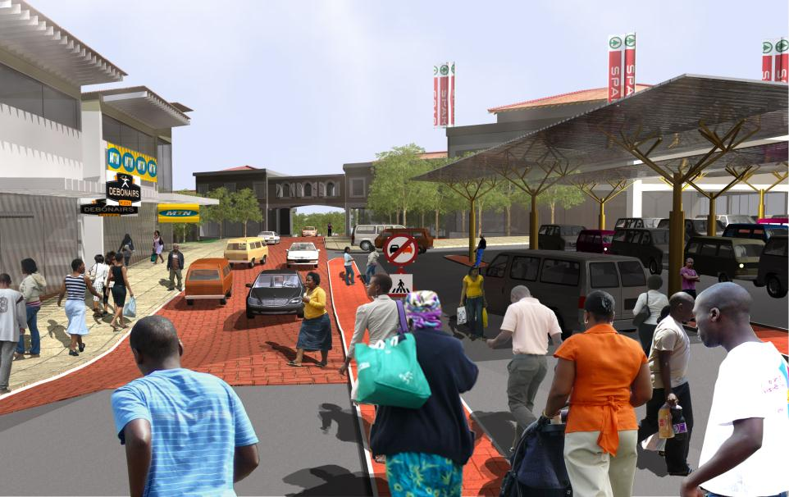

National Treasury
Neighbourhood Development Partnership Grant
Notes:
1

Slide 2
National Treasury
Neighbourhood Development Partnership Grant
PART | TOPICS
One | Background to the NDP & Context of New Strategy
Two | Urban Networks Strategy
Three | Towards Vibrant Urban hubs
Four | Explaining the Urban Network Strategy (UNS) Identification of Primary Network
Five | Application of UNS – Akanya
Six | Setting up a Management Structure New NDP Road Map and NDP Key Outputs Council Resolution / Memorandum of Agreement Support, Governance & Coordination Procurement of Service Providers Reporting: NDP Mgmt Information System (MIS)
Seven | Timelines: Planning Stage Questions & Discussion
Notes:
2

Slide 3
CONTEXT OF THE NEIGHBOURHOOD DEVELOPMENT PROGRAMME
The NDP was established in 2006 and is responsible for managing the Neighbourhood Development Partnership Grant. Grant Purpose:
From the start of the programme until the end of 2012/13 the NDP has:
  Approved municipal business plans to a value of R4.0bn
  Approved project plans to the value of R 3.9 bn.
  Completed 129 municipal NDP projects
  Disbursed a total of R615m to service providers and municipalities, 94% of its budget.
To support and facilitate the planning and development of neighbourhood development programmes and projects that provide catalytic infrastructure to leverage 3rd party public and private sector development towards improving the quality of life of residents in targeted underserved neighbourhoods (townships generally) Division of Revenue Bill, 2013 (Bill No. 02 of 2013)

Slide 4
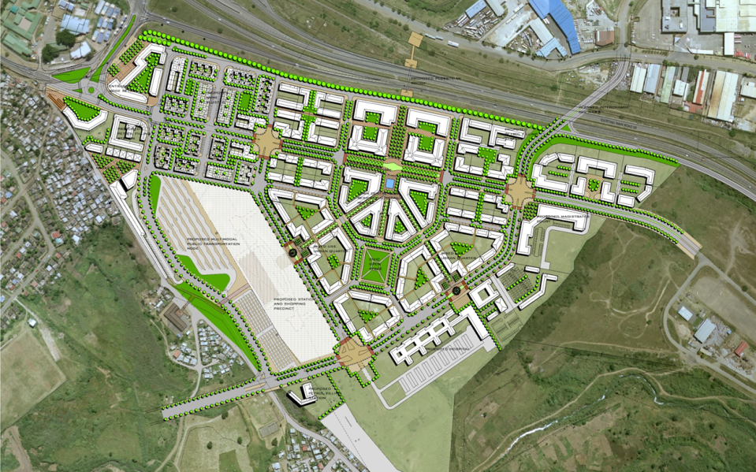
NDPG FUNDED URBAN HUBS IN SA CITIES: BRIDGE CITY, ETHEKWINI

Slide 5
NDPG: LESSONS LEARNT IN TOWNSHIP REGENERATION
Multiple spatially disparate “ad-hoc” township projects in the absence of an integrated and co-ordinated city-wide urban regeneration strategy has very low impact
  All spheres of government need to be involved.
Project prioritisation not to be informed by vested interests
Private fixed investment is dependant on the above
Limited municipal capacity to plan, assemble and align multiple funding sources in single large-scale mixed use development
Land issues dictate project progress and viability
Opportunities exist to develop and diversify township economies by leveraging mixed-use transit orientated development
Notes:
Undiversified and marginal local economies in townships

Slide 6
NDPG: LESSONS LEARNT IN TOWNSHIP REGENERATION
Need in
marginalised areas
Available
Resources
GAP

Slide 7
INTERNAL AND EXTERNAL FACTORS SHAPING & INFORMING THE NEW APPROACH OF THE NDP
During 2011/12 the NDP evaluated the performance of the NDP grant and as a result hereof embarked on a process of strategic planning to deepen value for money and long term impact.
The strategic role of urban centres in enabling the necessary conditions for achieving key government outcomes is well documented locally and internationally.
Alignment to Vision 2030 to address the urban and spatial components as highlighted in the National Development Plan
IGR’s Provincial and Local Government Infrastructure Chief Directorate also embarked on a support initiative via their City Support Programme (CSP).
The need to optimise National Treasury’s project prioritisation of infrastructure across sectors, spheres and public entities to enable the necessary conditions for sustained economic growth and development.
NT needs to operate at a more STRATEGIC LEVEL
to ensure optimal impact

Slide 8
OUTCOMES OF THE Neighbourhood Development Programme’s (NDP) REVIEW
Need to focus the NDP Grant on larger scale (functional regional) spatial interventions
Need to partner with other strategic spatial, transit orientated grants for projects in the urban hubs, transport linkages and housing in integration zones will be made available via the NDPG, PTIS (transport) and USDG (housing) grants.
A relocation of NDP to the City Support Programme within the Intergovernmental Relations Branch of NT to enable the NDP to play a more direct role in strategic infrastructure prioritisation
An adjustment of the NDP role as the Transferring National Officer and Grant Manager / Project Manager of the NDP Grant for rural (non urban) NDP municipalities.
Need to promote a strategic planning and investment framework to transform the spatial form of SA’s larger urban centres.

Slide 9
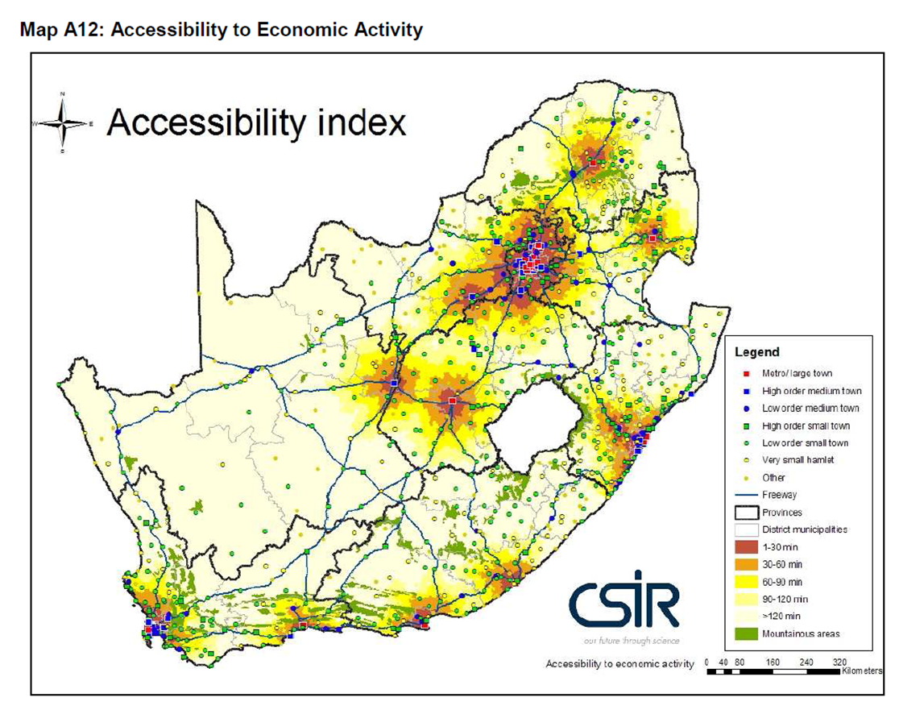
FOCUS IS ON CITIES AS THEY ARE THE CENTRES OF SOCIO-ECONOMIC ACTIVITY

Slide 10
focus on urban spatial form
Severe inequality is clearly represented in the spatial form of all our cities
  Deeply Exclusionary (spatial patterns of access to services and opportunity)
  Increasingly Inefficient (growing fiscal and economic costs in supporting the current spatial form and design)
  Ultimately Unsustainable (severe environmental and social risks)
Public policy unwittingly reinforced these divides, and set them in concrete
  A lack of adequate forward planning to deal with continuing pulling power of cities & environmental factors affecting cities
  A renewed focus on the quality of urban and economic growth is required

Slide 11


















a targeted investment programme in SA’s 18 larger urban centres

Slide 12
National Treasury
Neighbourhood Development Partnership Grant
PART | TOPICS
One | Background to the NDP & Context of New Strategy
Two | Urban Networks Strategy
Three | Towards Vibrant Urban hubs
Four | Explaining the Urban Network Strategy (UNS) Identification of Primary Network
Five | Application of UNS – Akanya
Six | Setting up a Management Structure New NDP Road Map and NDP Key Outputs Council Resolution / Memorandum of Agreement Support, Governance & Coordination Procurement of Service Providers Reporting: NDP Mgmt Information System (MIS)
Seven | Timelines: Planning Stage Questions & Discussion
Notes:
12

Slide 13
THE STRATEGY FOLLOWS A MULTI-SECTORAL APPROACH
Spatial
Economy
Social
Environmental
Institutional

Slide 14
THE NEW APPROACH WILL ENABLE GROWTH & DEVELOPMENT
Transit-orientated
Partnership-based
Targeted (precinct) investment
Aimed at strategic spatial transformation
Optimise access to social & economic opportunities, especially for the poor
Minimise transaction costs to participate in the urban economy
Replicable model

Slide 15
TAKING THE NEW NDP strategy Into action …
Strategic spatial planning
Urban network identification & planning
Objectives and performance targets
Identification of zones
Intervention planning
Zone and precinct planning
Objectives and performance targets
Identification of catalytic projects
Project Planning
Detailed design
Financing
Pipeline
Implementation management
Life-cycle Management
Precinct management
Investment facilitation
Performance monitoring and evaluation

Slide 16
THE TWO SPATIAL PRINCIPLES UNDERPIN THE URBAN NETWORKS STRATEGY
Primary Network
Secondary Network
The primary network is at city-wide scale and consists of anchor nodes, i.e. the CBD and a number of Urban Hubs, as well as Activity Corridors between these anchor nodes .
Secondary Nodes are smaller nodes within township areas connected to the Urban Hub and serving as “neighbourhood” or lower order nodes.

Slide 17
PRIMARY NETWORK LEVEL
Key Element | Description
CBD | Central business district of the city region. Focus on public transport modal facilities.
Urban Hubs | Function as “town centres” for the surrounding township or cluster of townships and will provide access to the rest of the wider urban area.
A limited number of established nodes | Established corridor nodes outside townships New “Urban Hubs” located within each township or cluster of townships
Emerging corridor nodes | Secondary nodes located on the Activity Corridor between the CBD and the Urban Hub
Activity corridor | Primary public transport link supporting a belt of land approximately 2km wide with a number of corridor nodes along the corridor.
Scale: Entire urban area - one or more adjacent municipalities

Slide 18
. . . IDENTIFY & STRENGTHEN HUBS . . .
PRIMARY NETWORK LEVEL

Slide 19
. . . CONNECT . . . PRIMARY NETWORK

Slide 20
SECONDARY NETWORK LEVEL
Connect secondary township nodes with Urban Hub
  Improved street and pavement infrastructure + open space systems
  Enable efficient movement of pedestrians, bicycles & taxis
  Lower order nodes to transform into secondary nodes over time
People from all locations within each township will have easy access to the Urban Hub
Scale: Individual township or cluster of townships

Slide 21
. . . CONNECT . . . SECONDARY NETWORK

Slide 22
DETERMINE ACTIVITY CORRIDOR

Slide 23
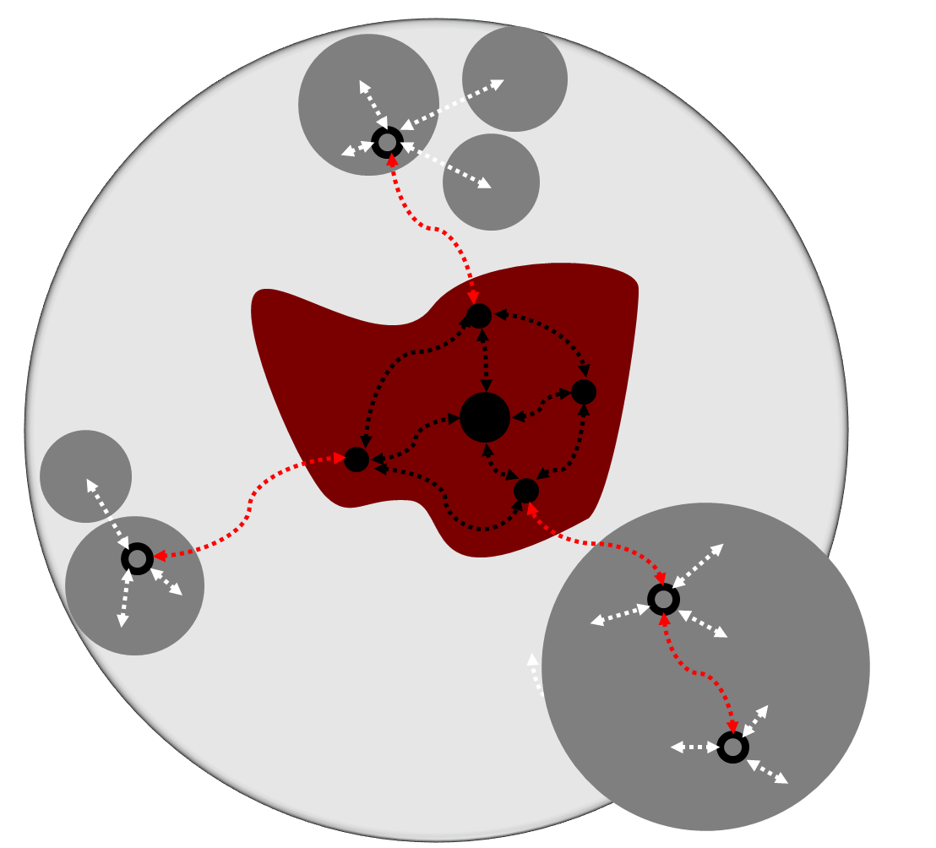
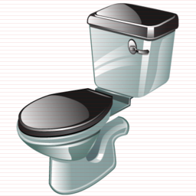



SUPPORTING INFRASTRUCTURE TO BE PRIORITISED TOWARDS TARGET AREAS

Slide 24
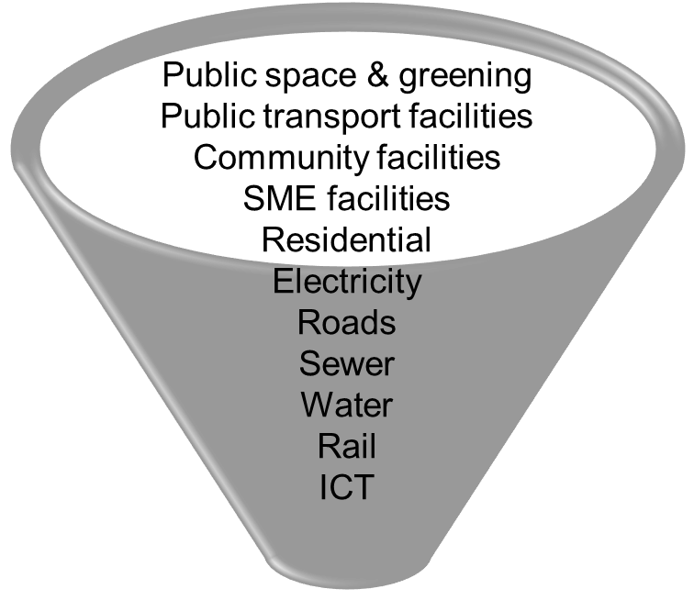
STRATEGIC URBAN LOCATIONS UNLOCK A PROJECT PIPELINE
SLIDE ONLY FOR NON CSP MUNI’s (10 Non Metros)
Urban Network | Network Elements | Intervention | Investment Phasing
Primary Network | CBD | Regeneration and management | Spatial Development Objectives Network Connectivity Optimisation
 | Urban Hubs | Mixed-use development and management
 | Primary Transport Link | Develop/Upgrade and management
 | Activity Corridor | Infill & Densification
Secondary Network | Secondary Transport Link | Develop/Upgrade

Slide 25
THE PIPELINE IS AIMED TOWARDS AN INTEGRATED FISCAL PACKAGE
SLIDE ONLY FOR NON CSP MUNI’s (10 Non Metros)
Underserved Townships
Developed Area
MIG
SHRZ
CBD
PTIS
NDPG
Underserved Townships
Underserved Townships
UDZ

Slide 26
Grant ICDG - 1: a performance-based Integrated City Development Grant
SLIDE ONLY FOR CSP MUNI’s (8 Metros)
Objectives
Spatial Transformation: more compact cities, developed through focus on Urban Network & Integration Zones
Good governance: enhanced planning and regulatory systems to complement investments
Eligibility
Minimum eligibility criteria for metros, including unqualified audits
Strategic Planning Window (13/14)
Performance Incentive Window (14/15)
Reward based on measurable progress with performance indicators
Management arrangements
NT vote with inter-departmental committee (part of CSP)
Allocations weighted by population, performance and eligibility
Managed by Neighbourhood Development Programme in line with Urban Networks Strategy
Identification of Integration Zones
Strategies and targets
Catalytic projects in Integration Zones
Zonal and Precinct Plans
CSP participation agreements
Identification of Urban Network
Institutional arrangements

Slide 27
ICDG Grant - 2: A facility to support preparation of catalytic investments on the urban network
SLIDE ONLY FOR CSP MUNI’s (8 Metros)
Public space & greening
Public transport facilities
Community facilities
SME facilities
Residential
Electricity
Roads
Sewer
Water
Rail
ICT
Private Sector/
Commercial investment
Project Implementation
Project Preparation Facility
PTIS
NDP
USDG
Other
Objective: Well conceptualised catalytic projects that are feasible, well designed, accurately estimated, delivered on time, on budget and to specifications

Slide 28
THE PIPELINE IS AIMED TOWARDS AN INTEGRATED FISCAL PACKAGE
SLIDE ONLY FOR CSP MUNI’s (8 Metros)
Underserved Townships
ICDG
USDG
Developed Area
IHHSG
SHRZ
CBD
PTIS
NDPG
Underserved Townships
Underserved Townships
UDZ

Slide 29
From strategy to action
SLIDE ONLY FOR CSP MUNI’s (8 Metros)
Urban Network Plan
Integration Zone 1
Social Housing Project
Bulk Water Project
Precinct / Hub Devt Project
UDZ Scheme
BRT Project
Integration Zone 2
Land Development Project
Informal Upgrade Project
CBD Renewal Project
Zoning Reform Project
Rail Station Upgrade Project
Catalytic Project Pipeline
Management and Performance Monitoring

Slide 30
The urban networks strategy is aimed at integrated growth & development
Strong urban network with a hierarchy of well connected nodes
Efficient flows of people, goods & information
Targeted public infrastructure that catalyses ubiquitous distribution of public & private sector investment
Good access to jobs & amenities
Primary Public Transport Links
CBD
Primary Corridor
Urban Hubs

Slide 31
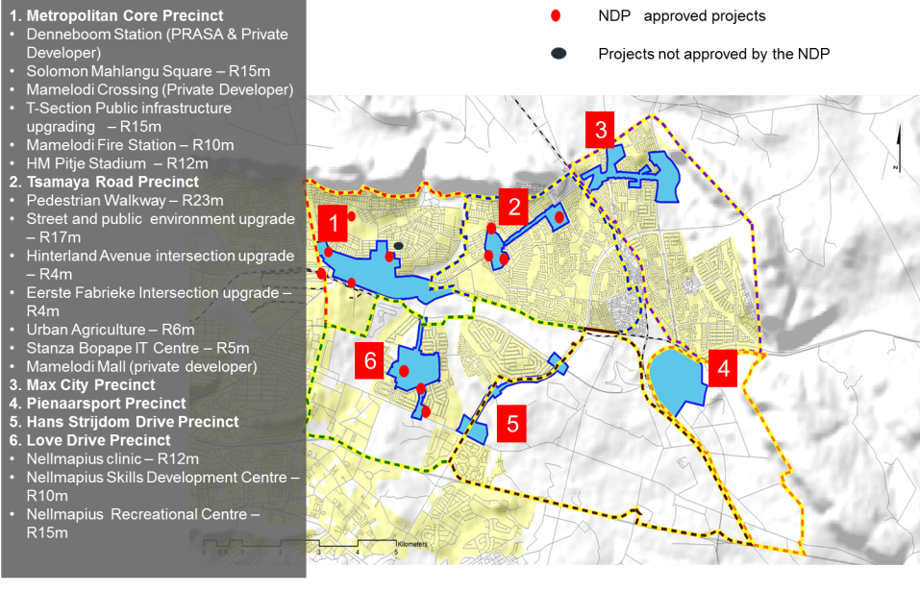
INVESTMENT CASE STUDY: MAMELODI
Numerous ad-hoc non integrated or aligned projects. Little co-ordination of public funds

Slide 32
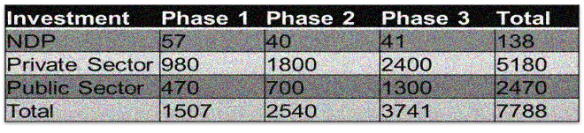
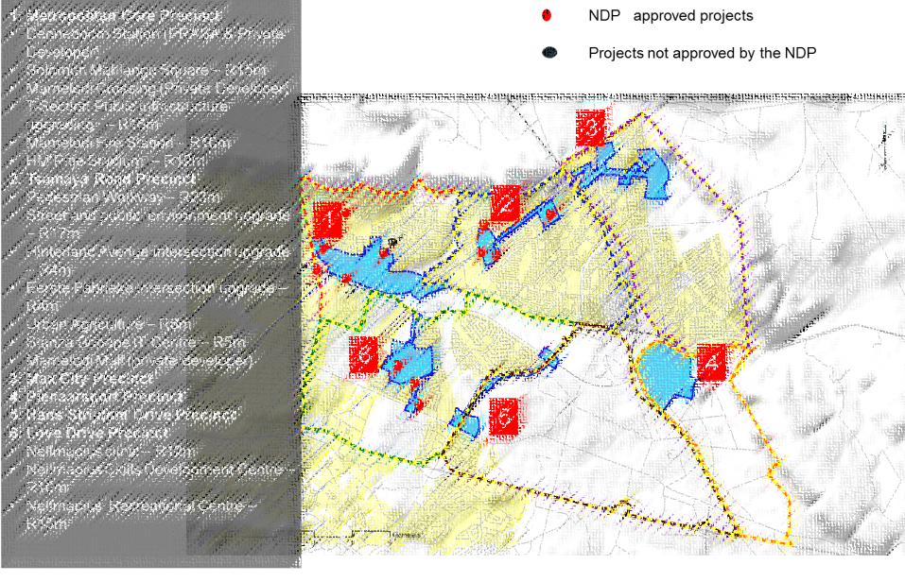

INVESTMENT CASE STUDY: MAMELODI
R138m
Urban Hub and secondary nodes, spatial logic, spatial targeting results in integrated or aligned projects. Better leverage through the co-ordination of Public funds

Slide 33

PILLARS OF URBAN NETWORK STRATEGY
Spatial transformation
Spatial targeting
Spatial clustering of current and future fiscal levers and instruments
Strategic urban spatial planning
Creating efficient & sustainable cities

Slide 34
National Treasury
Neighbourhood Development Partnership Grant
PART | TOPICS
One | Background to the NDP & Context of New Strategy
Two | Urban Networks Strategy
Three | Towards Vibrant Urban hubs
Four | Explaining the Urban Network Strategy (UNS) Identification of Primary Network
Five | Application of UNS – Akanya
Six | Setting up a Management Structure New NDP Road Map and NDP Key Outputs Council Resolution / Memorandum of Agreement Support, Governance & Coordination Procurement of Service Providers Reporting: NDP Mgmt Information System (MIS)
Seven | Timelines: Planning Stage Questions & Discussion
Notes:
34

Slide 35
TOWARDS VIBRANT URBAN HUBS
Investment friendly
Management friendly
Accessibility/
Walkability
Work
Live
People Centered
Hub
Mobility
Mobility
Live
Work
Accessibility
Accessibility
Services
Recreation
Safe
Green

Slide 36
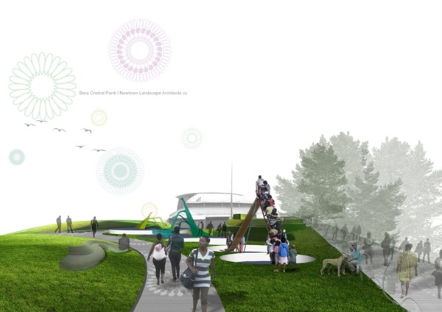
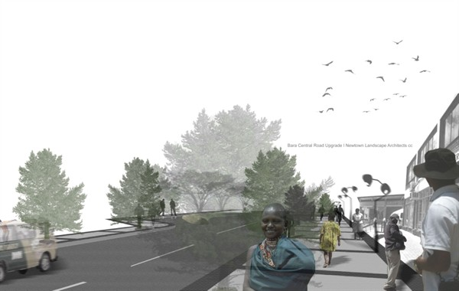
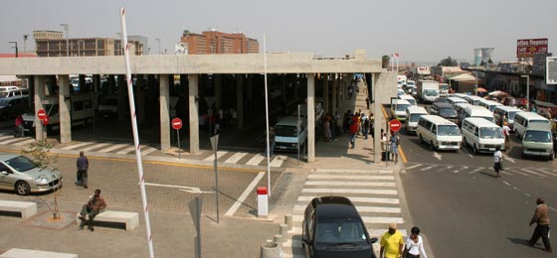
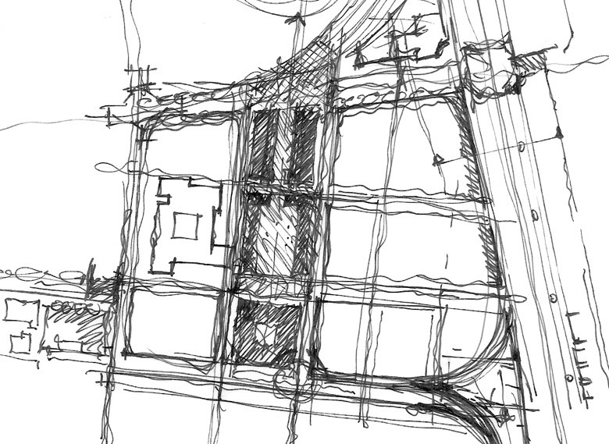
TOWARDS VIBRANT URBAN HUBS: Bara Central Development

Slide 37
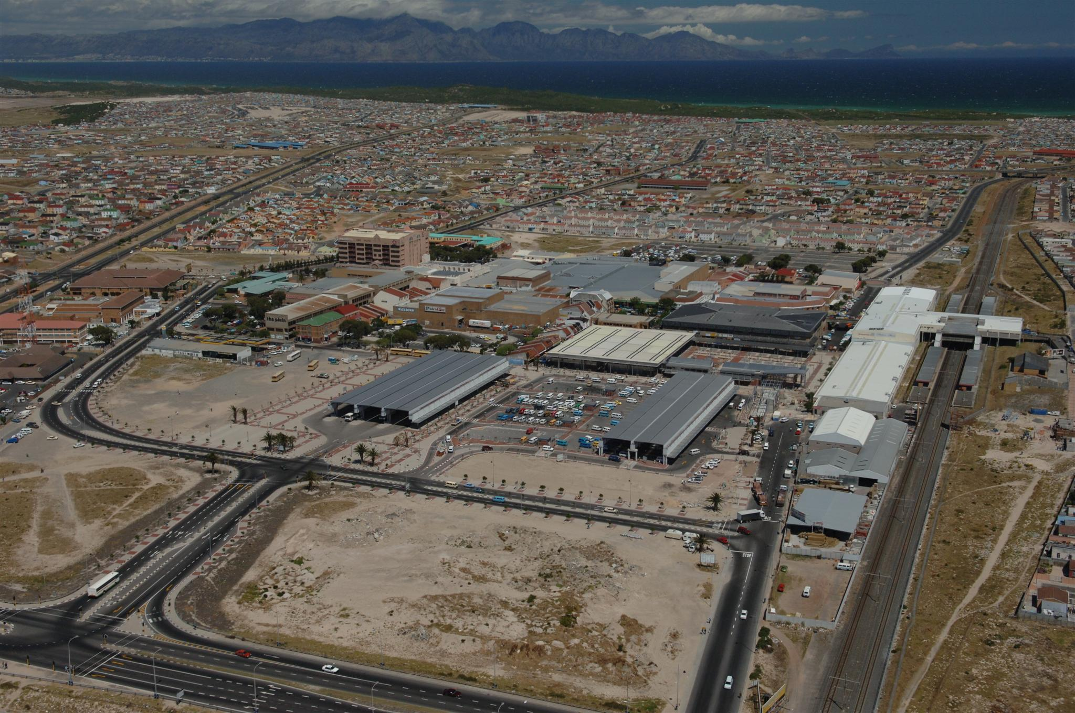
NDPG FUNDED URBAN HUBS IN SA CITIES:
MITCHELLS PLAIN

Slide 38
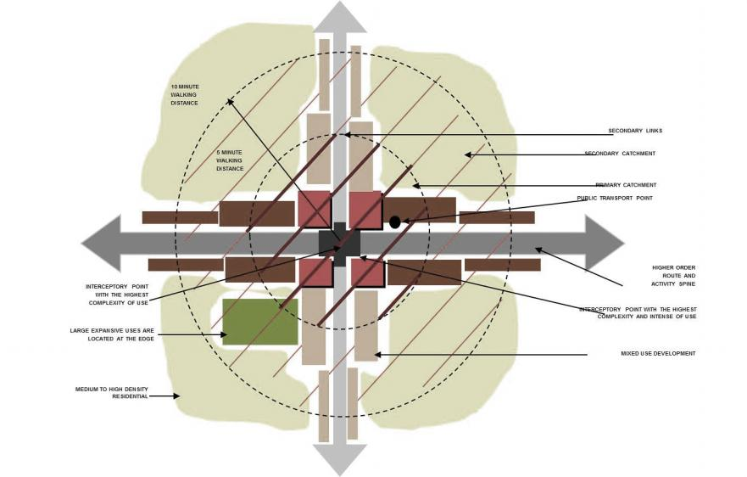
TOWARDS VIBRANT URBAN HUBS
High density, mixed use precinct that contains a diverse variety of land uses, services and activities
Function:
  “Town centre” for township/s
  Gateway to the rest of the wider urban area
Efficient intermodal public transport system & a network of public spaces and walkways
Land use mix:
  Retail
  Recreation, hospitality & tourism
  Offices, banking
  Community facilities & government services
  High density housing
Within an urban design framework that promotes a vibrant sense of place in which to live, work and play

Slide 39
Individual urban hub strategy to be determined via investment index
High
3. On a road to nowhere
Investment
Low
High
Diversity
No & Type of tenants (Traders, SME’s, National Chains)
Land Use Mix
Private/Public Split

Slide 40
CBD & Hubs require a clear precinct management strategy to ensure full life cycle optimisation
Objective: An inclusive, vibrant, safe, investment friendly hub
Economic Development
  Place marketing
  Lifestyle event management
  Risk management
Safety
    Security presence
    Active edges rather than dead zones - e.g. walls & vacant stands
  Clean and well maintained precinct public spaces
Precinct Management
Community
Municipality
Public Sector Investors
Private Sector Investors Developers
Traders
Tenants
Property Owners
40

Slide 41
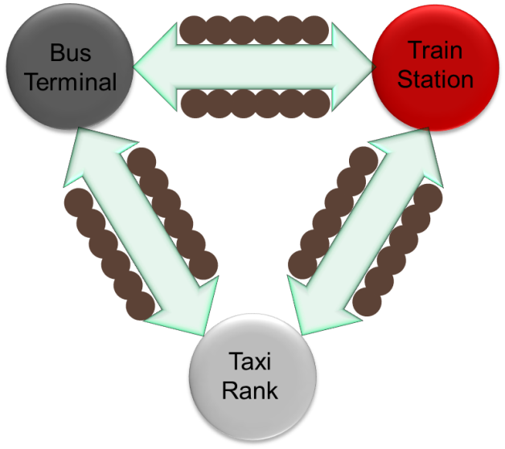
An urban design toolkit will assist cities to optimise vibrancy & investment
Identification of spatial structuring elements:
  Rail & road infrastructure
  Modal facilities
  Pedestrian network
  Public spaces
Planning & design principles for:
  Optimal clustering
  Making of a qualitative public realm
  Investment phasing towards private sector leveraging

Slide 42
CONVERGENCE OF PEOPLE IN HUBS TO ATTRACT PRIVATE SECTOR INVESTMENT

Slide 43
National Treasury
Neighbourhood Development Partnership Grant
PART | TOPICS
One | Background to the NDP & Context of New Strategy
Two | Urban Networks Strategy
Three | Towards Vibrant Urban hubs
Four | Explaining the Urban Network Strategy (UNS) Identification of Primary Network
Five | Application of UNS – Akanya
Six | Setting up a Management Structure New NDP Road Map and NDP Key Outputs Council Resolution / Memorandum of Agreement Support, Governance & Coordination Procurement of Service Providers Reporting: NDP Mgmt Information System (MIS)
Seven | Timelines: Planning Stage Questions & Discussion
Notes:
43

Slide 44
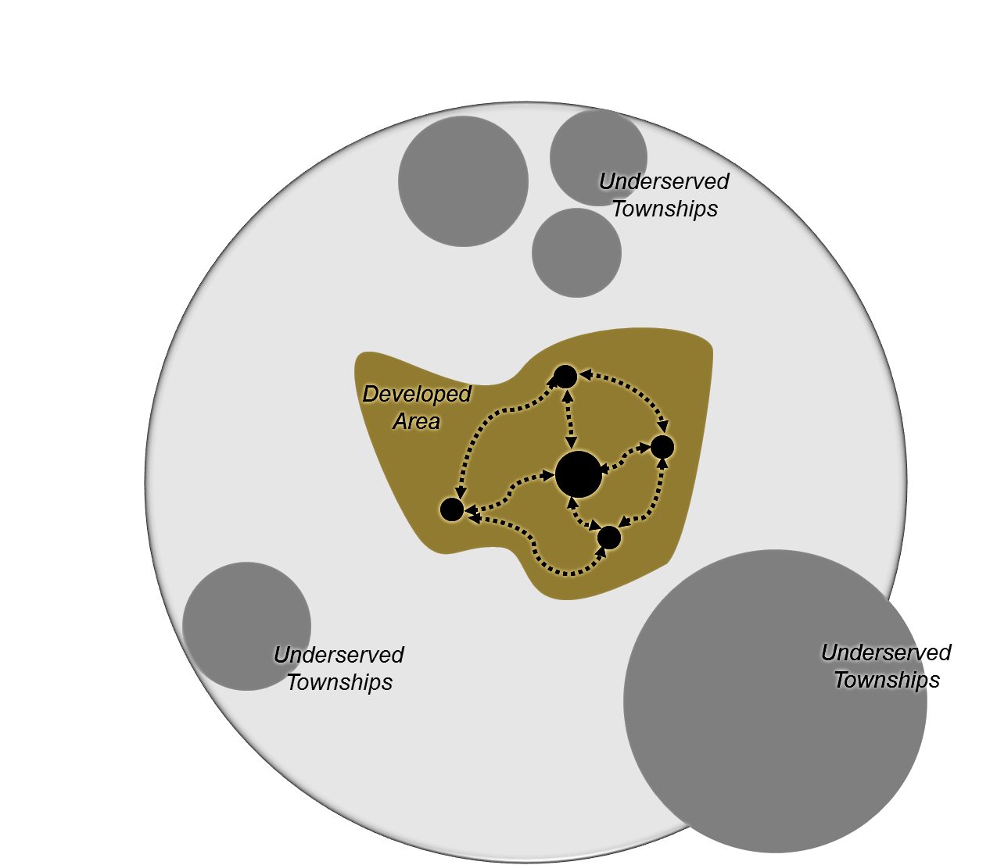
Urban Networks Approach
URBAN NETWORK
Municipal Outputs
Programme Plan
Network Elements
PRIMARY NETWORK
CBD
Precinct Plan
Established Corridor Node
CBD
Primary Public Transport Link
URBAN HUB
ACTIVITY CORRIDOR
Precinct Plan
Precinct Plan
Emerging Corridor Node
SECONDARY NETWORK: Secondary Public Transport Link
Secondary Node

Slide 45
IDENTIFICATION OF NETWORK ELEMENTS: PROCESS
STEP
OUTCOME
Regional Analysis: Primary Network and Township Clusters
Un-served Township Clusters
Focus Areas in the context of the primary network.
1
Local Analysis per Un-served Township Cluster – Hub ID
Existing urban structure: primary and secondary movement network, existing and planned nodes.
Prioritised existing or planned nodes at rail stations/public transport points.
2
Local Analysis
Primary and secondary network, including prioritised urban hubs.
One hub per township/township cluster
3

Slide 46
STEP 1: Regional Analysis – Primary Network and Township Clusters
1. MEASURE EXISTING SPATIAL DEVELOPMENT PATTERN
Identify primary movement network and primary nodes.
Identify townships.
Consider physical/natural barriers and local planning.
Demarcate un-served townships into clusters in context of primary network.
2. MEASURE PLANNED DEVELOPMENTS WITH IMPACT ON SPATIAL DEVELOPMENT PATTERN
Major planned developments e.g. Housing development, retail nodes etc.
Major planned movement lines/public transport.
Review first round demarcation to include new developments
3. MEASURE POPULATION THRESHOLD
Estimate population/household numbers for demarcated area.
4. MEASURE : SPATIAL EXTENT
Measure spatial extent – threshold radius for demarcated area.
Un-served Township Clusters
Focus Areas in the context of the primary network
outcome

Slide 47
STEP 2: Local Analysis per Un-served Township Cluster – Hub Identification
Zoom in on township cluster and analyse in more detail
5. MEASURE EXISTING NODES/KEY DEVELOPMENT AREAS:
Identify formally designated nodes/planned nodes/special development areas from part of the formal primary and lower order network.
Identify major private sector initiatives that my indicate future nodal expansion of development.
Identify regional key points (eg. Hospitals, stadia, tertiary education.
Identify secondary links between nodal areas.
6. MEASURE EXISTING LOCAL CONCENTRATIONS OF ECONOMIC ACTIVTY
From aerial photos/local documents and identify other areas with high intensity activity.
7. MEASURE :PROXIMITY TO MAJOR PUBLIC TRANSPORT FACILITIES; HIGH FLOW AREAS
Locate major stations/ranks/modal transfer points, areas with high levels of existing daily flows.
Highlight nodes/new points served by major rail transport facilities as first priority.
Where no rail, prioritise public transport routes.
Existing urban structure: primary and secondary movement network, existing and planned nodes.
Where no existing or planned nodes, key points in urban network.
Prioritised existing or planned nodes at rail stations/public transport points.
outcome

Slide 48
STEP 3: Local Analysis
8. MEASURE: POTENTIAL CONTRIBUTION TO SPATIAL INTEGRATION
If appropriate in terms of township location, located nodes that have potential to integrate the existing township and immediate surrounding areas or future development areas.
Mark prioritised nodes if criteria met.
MEASURE: PROXIMITY TO MAJOR PRIMARY MOVEMENT INTERSECTION/ENTRY POINT INTO TOWNSHIP
Locate major intersection and entry points into township, that connects township to regional primary network.
Mark prioritised nodes if criteria met.
MEASURE: PROXIMITY TO INTERSECTION OF PRIMARY AND SECONDARY MOVEMENT NETWORK
Local major intersections between above points in regional primary network and secondary network within township.
Mark prioritised nodes if criteria met.
outcome
Primary and secondary network, including prioritised urban hubs.
[One hub per township/township cluster = the identified existing or planned node that complies with the highest number of above indicators. ]

Slide 49
National Treasury
Neighbourhood Development Partnership Grant
PART | TOPICS
One | Background to the NDP & Context of New Strategy
Two | Urban Networks Strategy
Three | Towards Vibrant Urban hubs
Four | Explaining the Urban Network Strategy (UNS) Identification of Primary Network
Five | Application of UNS – Akanya
Six | Setting up a Management Structure New NDP Road Map and NDP Key Outputs Council Resolution / Memorandum of Agreement Support, Governance & Coordination Procurement of Service Providers Reporting: NDP Mgmt Information System (MIS)
Seven | Timelines: Planning Stage Questions & Discussion
Notes:
49

Slide 50
APPLICATION OF UNS METHDOLOGY
Paste in Akanya GIS MAPs for the specific municipality.
Make sure you do through the methodology step-by-step, indicating all the UNS elements.
DO NOT just “jump” to the hub location.

Slide 51
National Treasury
Neighbourhood Development Partnership Grant
PART | TOPICS
One | Background to the NDP & Context of New Strategy
Two | Urban Networks Strategy
Three | Towards Vibrant Urban hubs
Four | Explaining the Urban Network Strategy (UNS) Identification of Primary Network
Five | Application of UNS – Akanya
Six | Setting up a Management Structure New NDP Road Map and NDP Key Outputs Council Resolution / Memorandum of Agreement Support, Governance & Coordination Procurement of Service Providers Reporting: NDP Mgmt Information System (MIS)
Seven | Timelines: Planning Stage Questions & Discussion
Notes:
51

Slide 52




PLANNING
Engage
Compile Work Plan
Prepare Urban Network Plan
Prepare Precinct Plan
WORK PLAN
PRIORITISED URBAN NETWORK ELEMENTS: NODES (CBD, URBAN HUBS, ESTABLISHED AND EMERGING CORRIDOR NODES), LINKAGES & ACTIVITY CORRIDORS
SPATIAL STRUCTURE & PRIORITISED PROJECTS
MILESTONES
IMPLEMENTATION
OPERATIONS & MANAGEMENT
URBAN NETWORKS ROAD MAP
Design Development
Finalise Technical Documentation
Prepare Precinct Management Plan
Project Tender Evaluation
Implement Precinct Management Plan
Procurement
Prepare Annual Precinct Evaluation Report
Construction
MILESTONES
APPROVED PRECINCT MANAGEMENT PLAN
PRECINCT EVALUATION REPORT
Prepare Close-Out Documentation
MILESTONES
APPROVED PROJECT DESIGNS, TENDERS
PROJECT PLAN APPROVALS
CLOSE-OUT REPORT

Slide 53
PLANNING
Engage
Compile Work Plan
Prepare Urban Network Plan
Prepare Precinct Plan
WORK PLAN
PRIORITISED URBAN NETWORK ELEMENTS: NODES (CBD, URBAN HUBS, ESTABLISHED AND EMERGING CORRIDOR NODES), LINKAGES & ACTIVITY CORRIDORS
SPATIAL STRUCTURE & PRIORITISED PROJECTS
MILESTONES
IMPLEMENTATION
OPERATIONS & MANAGEMENT
URBAN NETWORKS ROAD MAP
Design Development
Finalise Technical Documentation
Prepare Precinct Management Plan
Project Tender Evaluation
Implement Precinct Management Plan
Procurement
Prepare Annual Precinct Evaluation Report
Construction
MILESTONES
APPROVED PRECINCT MANAGEMENT PLAN
PRECINCT EVALUATION REPORT
Prepare Close-Out Documentation
MILESTONES
APPROVED PROJECT DESIGNS, TENDERS
PROJECT PLAN APPROVALS
CLOSE-OUT REPORT

Slide 54
NEW ROADMAP: MUNICIPAL OUTPUTS
PHASE | OUTPUT | DESCRIPTION | CONTENT
Planning | Work Plan [Start Up] | Plan to confirm how Municipality intends to implement the NDP UNS | Management Structure Work Programme to Appoint Service Providers Reporting Arrangements Preliminary TA Cash Flow Council Resolution
 | Work Plan [Extended] | Extended version to explain how service provision appointment and key outputs will be executed. | Above content and: Service Provider Team Scope of Work Key Outputs Total Contract Value and Cash Flow for Service Provider Team Work Programme to complete Planning Phase Organisational Interface Key Risks

Slide 55
NEW ROADMAP: MUNICIPAL OUTPUTS
PHASE | OUTPUT | DESCRIPTION | CONTENT
Planning | Urban Network Plan | Strategic spatial document identifying, prioritising and managing Urban Network Elements. One Urban Network Plan per Municipality. TA or ICDG to be used. [3 months] | Contextual Analysis Identified and mapped township clusters. Identified and mapped network elements. Urban Networks Planning – explaining the physical organisation of network elements and interrelated spatial factors impacting on development. Implementation Plan.

Slide 56
NEW ROADMAP: MUNICIPAL OUTPUTS
PHASE | OUTPUT | DESCRIPTION | CONTENT
Planning | Precinct Plan | Document detailing the plan for the development of: An Urban Hub Activity Corridor CBD. The outcome of the Precinct Plan will be a detailed composition of the future spatial structure of the precinct by means of map/s as well as design guidelines. Precinct Plan will prepare the Municipality for submission of prioritised projects for approval by NDP. [6 months] | Contextual Analysis Detailed Urban Design Plan Design Guidelines Project Identification, Evaluation and Prioritisation Project Phasing and Packaging Project Concept Plans Leverage Plan Resources Stakeholder Management Strategy

Slide 57

NEW ROADMAP: MUNICIPAL OUTPUTS
PHASE | OUTPUT | DESCRIPTION | CONTENT
Implementation | Project Plan | Project Plan confirms the implementation details of a discrete project. Must be supported by: Detailed engineering/ architectural designs. Technical documentation sufficient for council submissions. Tender evaluation and approval information. Transfer of capital funding will only be allowed once a project has been approved [final submission of tender values submitted and approved by NDP]. | Refer to existing template on the NDP MIS.

Slide 58
NEW ROADMAP: MUNICIPAL OUTPUTS
PHASE | OUTPUT | DESCRIPTION | CONTENT
Implementation | Close-Out Report | Confirms finalisation of a discrete project. Purpose to: Ensure that completion was achieved. Confirm that project has been finalised within planned budget and timeframe. Objectives where achieved. Outline any events of significance. Confirm any unresolved disputes. Make suggestions on improvements. Confirm that quality of work is acceptable. Confirm that project history is available. Hand-over/s in case of construction project. | Refer to existing template on the NDP MIS.

Slide 59

NEW ROADMAP: MUNICIPAL OUTPUTS
PHASE | OUTPUT | DESCRIPTION | CONTENT
Operations and Management | Precinct Management Plan | Tool to optimize the use of existing resources and manage/maintain and improve key activities and priorities within a delineated area to ensure value for money and long term impact. One Precinct Management Plan per Precinct. | Precinct Management: Management of Services. Asset Maintenance. Marketing of Area. Risk Management. Economic Development: Employment. On-going Projects. Partnerships.

Slide 60
Council Resolution
SLIDE ONLY FOR CSP MUNI’s (8 Metros)
Council Resolution in support of:
  The identified Urban Network (and all network elements).
  Approves the receipt of the Integrated City Development Grant and the Neighbourhood Development Partnership Grant, subject to the terms and conditions of the programme
  Authorises the Municipal / City Manager to sign the Memorandum of Agreement between the Municipality and the National Treasury
  That separate vote numbers be created for the management of the Integrated City Development Grant and Neighbourhood Development Partnership Grant funding.
  Approves the development of a Built Environment Performance Plan for 2014/15 for submission in terms of the requirement of the Integrated City Development Grant.

Slide 61
Council Resolution
SLIDE ONLY FOR NON CSP MUNI’s (10 Non Metros)
Council Resolution in support of:
  The identified Urban Network (and all network elements).
  Approves the Neighbourhood Development Partnership Grant, subject to the terms and conditions of the programme
  Authorises the Municipal / City Manager to sign the Memorandum of Agreement between the Municipality and the National Treasury
  That separate vote numbers be created for the management of the Neighbourhood Development Partnership Grant funding.
  The identified Municipal Governance Structures and Project Coordination (Assigned at Director level minimum)

Slide 62
Memorandum of Agreement (MOA)
The purpose of the MoA is to define the relationship in terms of the NDPG funding.
Where a Municipality has already been in a relationship with the NDP this document will replace the existing funding agreement
The MoA:
  Explains and sets forward objectives and outcomes of the NDPG
  Defines the roles and responsibilities of the NDP and municipality.
The MoA is first signed by Municipality and then by NDP
  A copy to be forwarded to the Municipality.

Slide 63
MUNICIPAL NDP SUPPORT, GOVERNANCE AND CO-ORDINATION
The aim is to incorporate and align the UNS within the Municipal SDF, IDP and operations.
The oversight of the NDPG needs to sit within a steering / executive committee of the municipality that deals with all strategic spatial matters (ideally chaired by Municipal Manager (MM) or deputy MM).
Stemming from the council resolution and a signed Memorandum of agreement the municipal NDP Coordinator will be identified (director level at minimum)
The Municipal NDP Coordinator can be supported by a additional programme / project manager to assist with NDPG reporting
The municipality is requested to share their “NDP” organogram of responsible officials and functions.
Notes:
63

Slide 64
PROCUREMENT OF SERVICE PROVIDERS
Municipality to determine capacity required from service providers and communicate to NDP.
Terms of Reference (ToR) Template available but should be adjusted to accommodate specific requirements of Municipality.
Final ToR to be shared with the NDP by the Municipality.
NDP benchmarks costs and value in terms of the outputs.

Slide 65
Municipal Reporting: NDP MIS
Reporting to be done by means of the Monthly Progress Report on the NDP Management Information System (MIS) via the Web.
Funds [TA/CG] will be withheld should Municipalities not report every month.
Access to be made available for new Municipalities – submit a request to Project Director.

Slide 66
National Treasury
Neighbourhood Development Partnership Grant
PART | TOPICS
One | Background to the NDP & Context of New Strategy
Two | Urban Networks Strategy
Three | Towards Vibrant Urban hubs
Four | Explaining the Urban Network Strategy (UNS) Identification of Primary Network
Five | Application of UNS – Akanya
Six | Setting up a Management Structure New NDP Road Map and NDP Key Outputs Council Resolution / Memorandum of Agreement Support, Governance & Coordination Procurement of Service Providers Reporting: NDP Mgmt Information System (MIS)
Seven | Timelines: Planning Stage Questions & Discussion
Notes:
66

Slide 67
Key actions and timelines
SLIDE ONLY FOR CSP MUNI’s (8 Metros)
By 1 Aug 2013:
Council resolution approving participation in the CSP/NDPG
Institutional arrangements
Confirming ICDG / NDPG conditions (Memorandum of Agreement)
Urban Network identification
By 1 Nov 2013
Urban Network Planning including identification of Integration Zones - demonstrate how the zones will contribute to the optimisation in connectivity across the Urban Network hierarchy
Detailed description of zone boundaries
Required adjustments to SDFs, LUM regulations, UDZs and SHRZs
Service Provider procurement & capacity support requirements
By 1 May 2014
BEPP Indicators, milestones & multi-year targets
One Zone / Precinct Plan completed
Catalytic projects identified with timeframes

Slide 68
Timelines: planning
SLIDE ONLY FOR NON CSP MUNI’s (10 Non Metros)
ENGAGE |  | COMPILE WORK PLAN |  |  | PREPARE PROGRAMME PLAN | PREPARE AREA BASED PLAN
Engage 1 | Engage 2 | Compile Municipal Work Plan | Procure Service Provider | Compile Service Provider Work Plan
Done | In-progress | Date | Date | Date | Date | Date
4 WEEKS
4 MONTHS
URBAN NETWORK ELEMENTS
IDENTIFIED
2 WEEKS
MUNICIPAL WORK PLAN
3 MONTHS
COUNCIL RESOLUTION
6 MONTHS
MEMORANDUM OF AGREEMENT

Slide 69


Questions & Discussions

