Slide 1
ISO 14001:2004 Requirements
EMS

Slide 2

Course Outline
Introduction to EMS
Requirements of ISO 14001:2004 standard
Initial Environmental Review
Assessment of Significant Aspects

Slide 3

Course Outline
Introduction to EMS

Slide 4
RELATIONSHIP BETWEEN POPULATION, CONSUMPTION AND ENVIRONMENTAL IMPACTS
x
Global population
Per capita consumption
=
Global Environmental Impact
Environmental Technology

Slide 5
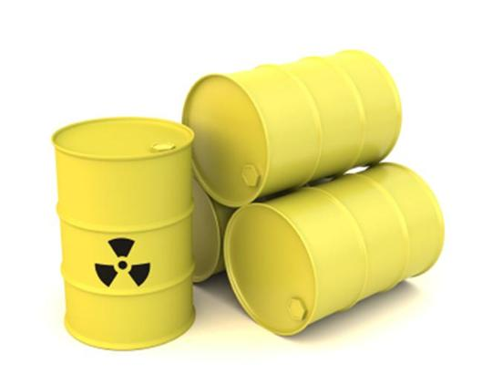
Environmental protection in the past 30 years
End of pipe treatment
Focus on manufacturing and industrial sector
Economic and Environmental objectives in conflict
Legal control more than voluntary compliance

Slide 6

What do we need in the 21st century?
Think system
Involvement of all staff
Design for productivity
Consider efficiency of energy and raw materials
Monitoring of growth (i.e. business expansion)
Government incentives/flexibilities
Prevention
Support from management level
Voluntary self compliance

Slide 7
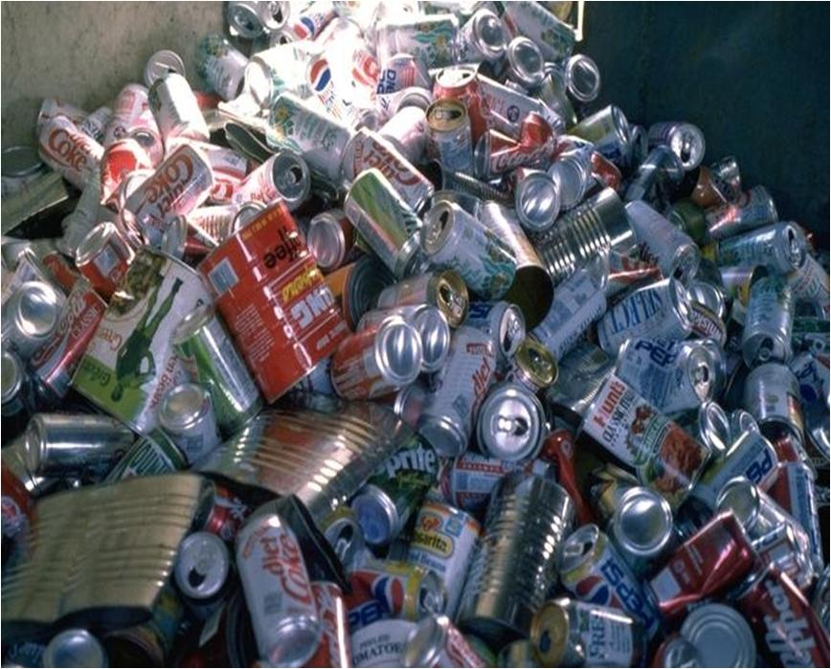
Environmental Management can be done through:
source reduction
waste reduction
waste recycling
treatment

Slide 8
Hierarchy of environmental management
SOURCE
REDUCTION
Don’t buy it!
End product redesign,
Hazardous chemical substitution,
Hazardous chemical modification,
Purchasing and inventory control, best
Management practice and good housekeeping
WASTE REDUCTION – Don’t waste it!
Benchmarking, employee training, maintenance, process control
Process modification and equipment modification
WASTE RECYCLING – Don’t throw it away!
Closed loop recycling, waste segregation, reuse waste, reclaim waste
TREATMENT – Turn waste into resources!
Convert waste into new products, find outside users for wastes

Slide 9

What is ISO?
ISO - International Organization for Standardization
Non-Governmental organization
Began its official functions on February 23, 1947
ISO from Greek word “ISOS” meaning “equal”

Slide 10
Mission of ISO:
Promotion of the development of standardization and related activities in the world with a view to:
  Facilitate the international exchange of goods and services
  Develop cooperation in the spheres of intellectual, scientific, technological and economic activity

Slide 11

Rationale for the EMS
EMS when integrated with other management systems (i.e. QMS), can help achieve environmental and economic goals
Enables the organization to develop and implement a policy and objectives which take into account legal requirements and information about significant environmental aspects.
Provides the framework for continual improvement on environmental objectives and targets.

Slide 12

What's in it for me?
Improved company credibility
Competitive advantage in the market place
Reduced trade barrier
Satisfy stakeholders interest

Slide 13
What's in it for me?
Reduced raw material usage
Reduced energy consumption
Reduced waste disposal cost
Recoverable resources
Reduced penalties and insurance premium
Continuity of operation and increased efficiency
Fewer accidents

Slide 14

ISO 14000 Family of Standards
ISO 14001:2004
ISO 14004:2004
ISO 19011:2002

Slide 15

ISO 14001
  specifies requirements for an environmental management system to enable an organization to develop and implement a policy and objectives, and information about significant environmental aspects.

Slide 16

ISO 14004
Provides organizations requiring more general guidance on a broad range of EMS issues.

Slide 17

ISO 19011
provides guidelines on auditing quality and environmental management systems.

Slide 18
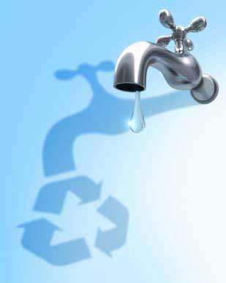
The purpose of ISO 14000 standards
Reduced pollution and negative effects
Improved utilization of resources
Does not replace legislative and regulatory requirements
Does not specify environmental performance criteria
Q
ACF

Slide 19

ISO 14001:2004 STANDARD REQUIREMENTS

Slide 20
The scope of ISO 14001 standard
CLAUSE # DESCRIPTION
1 Scope
2 Normative Reference
3 Terms & Definitions
4 Environmental Management System Requirements
4.1 General Requirements
4.2 Environmental Policy

Slide 21
The scope of ISO 14001 standard
CLAUSE # DESCRIPTION
4.3 PLANNING
4.3.1 Environmental aspects
4.3.2 Legal and other requirements
4.3.3 Objectives, targets and programme(s)

Slide 22
The scope of ISO 14001 standard
CLAUSE # DESCRIPTION
4.4 IMPLEMENTATION AND OPERATION
4.4.1 Resources, roles, responsibility and authority
4.4.2 Competence, training and awareness
4.4.3 Communication
4.4.4 Operational control
4.4.5 Emergency preparedness and response

Slide 23
The scope of ISO 14001 standard
CLAUSE # DESCRIPTION
4.5 CHECKING
4.5.1 Monitoring and Measurement
4.5.2 Evaluation and Compliance
4.5.3 Nonconformity, corrective action and preventive action
4.5.4 Control of Records
4.5.5 Internal audit
4.6 Management Review

Slide 24

EMS Model
Environmental Policy
Implementation & Operation
Checking
Management Review
Planning
Continual Improvement

Slide 25
EMS Implementation Cycle
Environmental Policy
Regulations, aspects & impacts
Objectives & Targets
Organization & Personnel
Management Programs
Management Procedures
Operational Control
Records
EMS Audits
Mgt Review

Slide 26

What does an EMS do?
Establishes the EMS Policy, Objectives and Targets
Prevents problems rather than fixing them later
Provides evidence of compliance
Makes effort for continual improvement

Slide 27
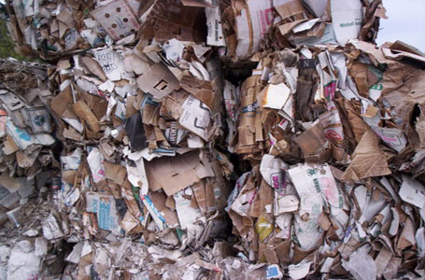
EMS Needs
Means / methods
Resources
Training
Time frame
Documentation / reporting
Communication
Operational control

Slide 28
1 Scope
Applicable to any organization that wishes to:
establish an EMS
assure itself of conformity with its stated environmental policy
demonstrate conformity by:
  making a self-determination and self-declaration
  seeking confirmation of its conformance
  seeking confirmation of its self-declaration by external party
  seeking certification/registration

Slide 29
2 Normative reference
No normative references are cited. This clause is included in order to retain clause numbering identical with the previous edition (ISO 14001:1996).

Slide 30
4.1 General Requirements
Establish, document, implement, maintain and continually improve an environmental management system
Define and document the scope

Slide 31
4.2 Environmental Policy
Appropriate to the nature, scale and environmental impacts of activities, products and services.
Include a commitment to continual improvement and prevention of pollution.
Include a commitment to comply with applicable requirements and with other requirements to which the organization subscribes which relate to its environmental aspects
Provide the framework for setting and reviewing environmental objectives and targets.
Is documented, implemented, maintained
Is communicated to all persons working for or on behalf of the organization
Is available to the public

Slide 32
Environmental Policy
It is the policy of Company ABC to conduct all business activities in the manufacturing of Coils, Coil Assemblies and Integrated Molds in a responsible manner for the protection and preservation of the environment.
ABC is committed to comply with all applicable environmental legal and other requirements. Reviewing its products, activities, environmental objectives and targets for the conservation of resources, prevention of pollution for continual improvement.

Slide 33
Writing the Policy
Should reflect top management’s commitment to comply requirements, prevention of pollution and continual improvement
Area of application should be identified
Forms the basis for setting the objectives and targets
Easy to understand by interested parties

Slide 34
The Policy should be:
Communicated to all persons who work for, or on behalf of, the organization. Including contractors working at an organization’s facility.
Defined and documented by its top management

Slide 35
4.3 Planning
Environmental Aspects
  Definitions:
  Environmental Aspects: an element of an organization’s activities or products or services that can interact with the environment.
  Environmental Impact: any change to the environment, whether adverse or beneficial, wholly or partially resulting from an organization’s activities, products or services.

Slide 36
4.3 Planning
4.3.1 Environmental Aspects
  Establish, implement and maintain procedure(s) to:
  identify environmental aspects of its activities, products and services within defined scope of the EMS
  determine those aspects that have or can have significant impact(s) on the environment

Slide 37
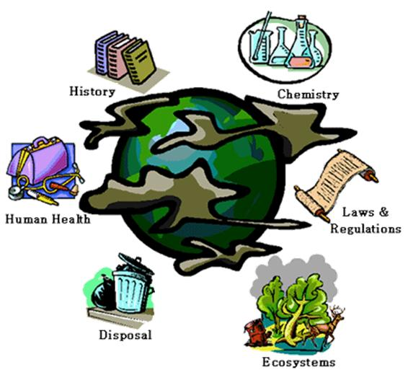
Environmental problems
Global warming
Stratospheric Ozone depletion
Acid rain
Water quality
Air quality
Noise / vibration
Visual impact
Waste management
Contaminated land
Major spills and incidents
Release of genetically manipulated organisms

Slide 38
Issues for the industry
Air pollution
Water pollution
Water usage and other resource usage
Hazardous substances
Biological hazards
Radiation
Waste
Noise
Community concerns
Wildlife and habitats
Accidents and emergencies
Interface with other heath and safety issues

Slide 39

Aspects – normal, abnormal, emergency
Air Emissions
Liquid releases
Waste management
Land contamination
Use of materials and resources
Noise, odor, dust, vibration, visual impact
Eco systems aspects
Transport / contractors
Other

Slide 40
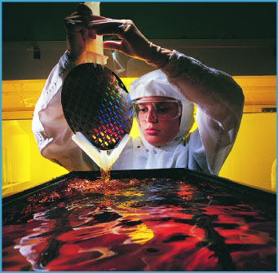
Identification of aspects - Tools
Product review (Life cycle analysis)
Site assessment
Product/process data review
Communications review
Compliance audit
Walk through audit
Past performance review
Referred to as “Initial review” or “Preparatory Environmental Review” (PER)

Slide 41
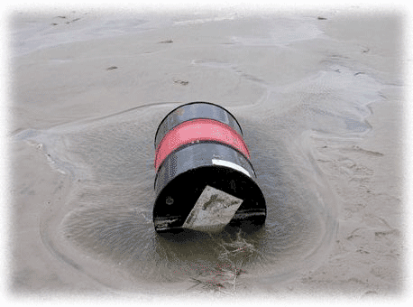
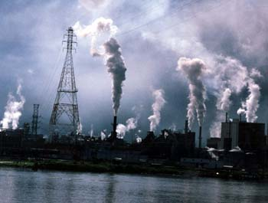
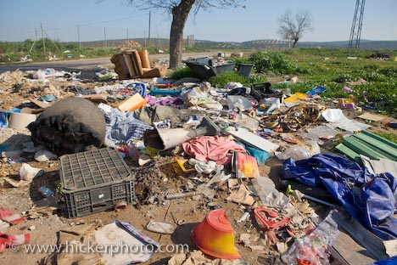
What should be considered in identifying the environmental aspects?
Emissions to Air
Releases to Water
Releases to Land
Use of raw materials and natural resources
Use of Energy
Energy emitted, e.g. heat, radiation, vibration
Waste and by-products

