Slide 1

Introduction to Integrated Management System

Slide 2
Course Outline
Basics of ISO and Management Systems
Basics of Integrated Management System
Common elements that can be integrated

Slide 3
What is Management System?
Framework of processes and procedures used to ensure that an organization can fulfill all tasks required to achieve its policy and objectives
Are based on recognized/available/organization specific
standards or best practices
Reflect the company management’s commitment
Are dictated by customer or contractual requirements
Are commitment to succeed in the marketplace
When properly implemented and, with committed leadership, can contribute greatly to the success of businesses
Could be self-declared or third party certified

Slide 4
What is Management System?
QMS is a set of policies, processes, and procedures required for planning and execution (production/development/service) in their core business area of an Organization.
EMS is that part of the overall management structure which addresses the immediate and long term impact of its products, services and processes on environment.

Slide 5
Typical Structure of Management System?
Policy
Systems & Procedures
Work Instructions
The Management System addresses the top, middle and lower managerial levels in the organization.

Slide 6
What do we mean by an integrated management system?
Integrated means combined; putting all the internal management practices into one system but not as separate components.
For these systems to be an integral part of the company's management system there have to be linkages so that the boundaries between processes are seamless.
An integrated management system (IMS) is a management system which integrates all components of a business into one coherent system so as to enable the achievement of its purpose and mission.

Slide 7
Basics of Systems Integration
Organizations may need many management systems depending upon their activities and requirements
Can be without relationship amongst each other existing simultaneously
  Independently-implemented
  Independently-functioning
  Independently-managed systems
Or can be ‘integrated’, sharing, where possible
  Common elements
  Common resources
  Common management

Slide 8
Basics of Systems Integration
ISO 9001
ISO 14001
OHSAS 18001
Other systems like TQM, Six sigma
Integrate as relevant, feasible and applicable
By integration, the various systems serve their intentions but as a single functional management system

Slide 9
Why should management systems be integrated?
Be consistent within the organization.
Improve internal and external communication.
Avoid duplication and gain cost savings.
Reduce risks.
Expose conflicting objectives.
Identify and rationalize conflicting responsibilities and relationships.
Gain a structured balance of authority/power.
Focus organization onto business goals.
Create a formalization of informal systems.
Harmonize and optimize practices.
Identify and facilitate staff training and development.

Slide 10

Which Management Systems standards can be integrated?
Typically:
  ISO 9001 (Quality Management)
  ISO 14001 (Environmental Management)
  OHSAS 18001 (Occupational Health & Safety)
  ISO/IEC 27001 (Information Security)
  ISO 22000 (Food Safety)

Slide 11


Management System Targets
QMS – The Customer
EMS – Stakeholders, Regulators

Slide 12
ISO 9001:2008 REQUIREMENTS

Slide 13

Continual Improvement of the
Quality Management System
Customers
(and
other
interested
parties)
Customers
(and
other
interested
parties)
Management Responsibility
Resource Management
Measurement, Analysis & Improvement
Requirements
Product Realization
Satisfaction
Product
Model of a Process-Based QMS

Slide 14

QMS Approach
Customer needs & expectations
Continual improvement
Quality Policy & Objectives
Corrective action
Processes & responsibilities
Applying measures
Resources
Establish methods to measure
Such an approach is also applicable to maintaining and improving an existing quality management system.

Slide 15

ISO 14001:2004 REQUIREMENTS

Slide 16

EMS Model
Environmental Policy
Implementation & Operation
Checking
Management Review
Planning
Continual Improvement

Slide 17
EMS Implementation Cycle
Environmental Policy
Regulations, aspects & impacts
Objectives & Targets
Organization & Personnel
Management Programs
Management Procedures
Operational Control
Records
EMS Audits
Mgt Review

Slide 18
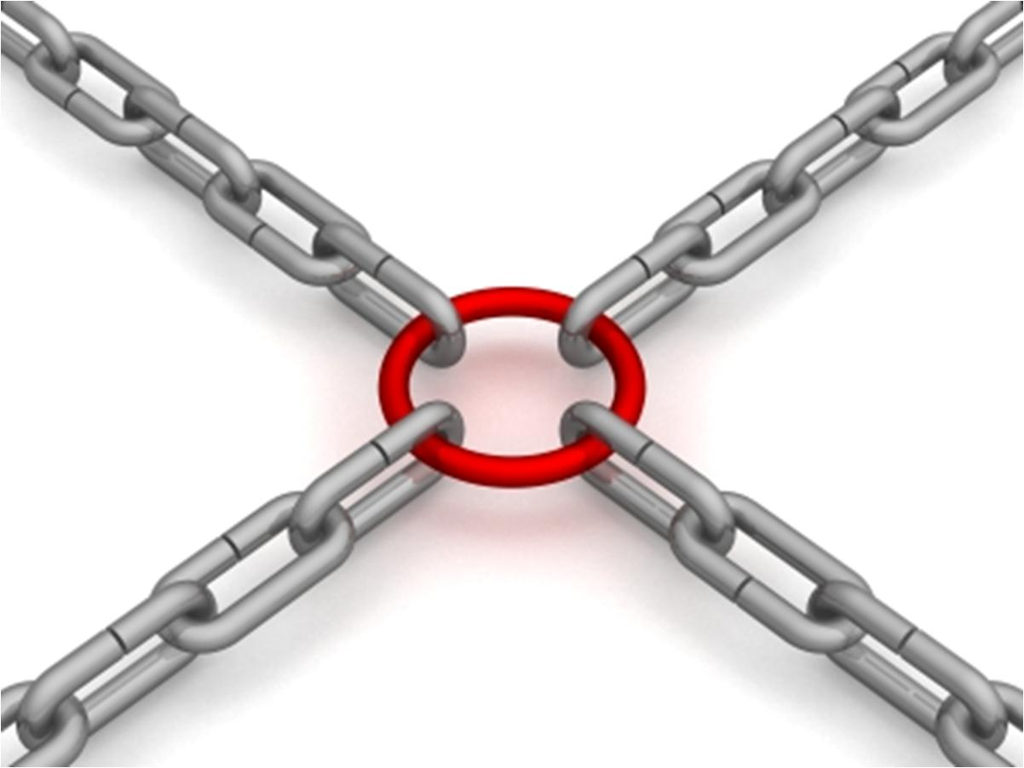
Common elements from different systems
Policy
  Can be integrated across quality, environment and safety
  Can be common for corporate, multiple sites / locations
  Helps also in simplifying communication of the policy
Initial reviews (and departmental reviews)
  Baseline monitoring and measurement
  Monitoring agencies / equipment
  Timing

Slide 19
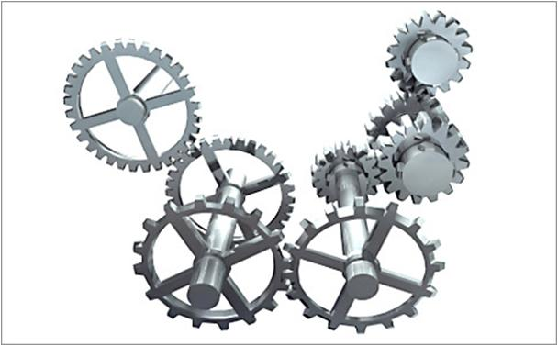
Common elements from different systems
Gap assessment and analysis
  Identification of quality / customer requirements, environmental aspects and risks
  Cause-effect relationships / brainstorming
Reports
  Format and structure
Legal and Other Requirements
  Common regulatory updates / reviews

Slide 20

Common elements from different systems
Roles and responsibilities
  Common structure for R&R
  Similar tasks across systems could have common responsibility allocation
    MR could be common for at least QMS and EMS if practically possible
Training and capacity building
  Combined needs assessment
  Timing and participation can be optimized

Slide 21

Common elements from different systems
  Awareness sessions for systems could be combined wherever possible
  Internal auditors can be trained on all 2 systems (combined auditors)
Communication
  External and internal communication (respectively) can be integrated for the 2 systems - common procedures and protocols
  Formats, common channels of communication

Slide 22

Common elements from different systems
Operation control
  Common metrics for measurement on quality and environmental parameters
    Process parameters
    Operating criteria considers all requirements
    Incoming material quality/product quality
    Customer satisfaction
    Environmental Performance
  Effectiveness of training across all systems

Slide 23

Common elements from different systems
Audits
  Combined external and surveillance audits
  Combined internal audits / common internal auditors
  Common formats / audit checklists
  Staff downtime can be minimized
Non-conformance and CAPA
  Self-NCRs
    Product not meeting customer requirements in terms of product or process requirements
    Nonconformance identified in audits
    Customer complaints

Slide 24

Common elements from different systems
    Incoming materials not meeting purchase acceptance requirements
    Accidents (and minor and major injuries)
    Breaches to legal and other requirements
    Deviations from procedures / emergency situations
Management review meetings
  Combined review meetings
  Better and faster approvals / decision making
  Better coherence in decision making due to consideration of cross linkages
  Common review of policy and objectives

