Slide 1

B
enchmarking

Slide 2

Objectives
  Understand how benchmarking contributes to world-class leadership
  Understand benchmarking concepts
  Create the environment within the company to foster benchmarking
  Be able to create an implementation strategy

Slide 3

Benchmarking
  Is an activity an organization uses to establish a leadership position.
  Is a point of reference against which other things are compared or measured.

Slide 4

Benchmarking
  Focuses on establishing a leadership position
  Identifies world-class organizations, products (both goods and services), and business practices
  Evaluates the reasons for their being world-class
  Systematically and continuously integrates that knowledge into the organization’s products and processes

Slide 5
Benchmarking
Compared to the best
Become Industry Leader
Attain competitive advantage
Take action
Set new targets
Adapt learning
Learn from Best
Compared to the best

Slide 6

Key elements of benchmarking
  Competition
  Measurement
  More than competition analysis or market research
  Companies renowned as functional leaders
  Customer satisfaction
  Openness to new ideas
  Continuous process

Slide 7

Benchmarking measurement
Benchmark Company
Performance
The “gap”
Your Operation’s Performance
Now

Slide 8
Benchmarking measurement
Your Operation’s Performance (new benchmark)
The “gap”
Programs
Benchmark Company
Your Operation’s Performance
Performance
Programs
Your Operation’s Performance
The future

Slide 9
Benchmarking, market research and competitive analysis
Market research
Competitive Analysis
Benchmarking
Purpose
Analyze markets or product acceptance
Analyze competitors’ strategies
Analyze what, why and how well benchmarks are doing
Focus
Customer needs
Competitive strategies
Practices that satisfy customer needs
Sources
Customers
Industry analysts
Internal and external data and original research

Slide 10

Benchmarking, market research and competitive analysis
Your company
World Class
Benchmark company
Benchmark
effect
Good
Trouble
Benchmarking project
Now
Future

Slide 11

Why benchmark?
  Stay in business
  Delight the customer
  Become the World-class Leader

Slide 12

The power of learning
  Asking questions is the critical beginning
  Listening to the answers is on the path to renewal
  Acting on the answers separates the long-term winners from the “also-rans”
  Repeating the cycle is the essence of leadership

Slide 13

Rapid Change
  238 companies dropped out of the Fortune 500 between 1955-1980
  143 companies dropped out between 1985-1990
  Of the 43 “excellent” companies cited in Peter & Waterman’s book In Search of Excellence in 1982, only 14 companies were still considered “excellent” eight years later

Slide 14

43 “Excellent” Companies of 1982
  Allen Bradley (Rockwell)
  Disney
  Boeing
  DEC
  Emerson
  Frito-lay
  IBM
  Intel
  Johnson & Johnson
  Mars
  Maytag
  McDonald’s
  Merck
  Walmart
32%
  Amdahl
  Bechtel
  Caterpillar
  Dans
  Hewlett-Packard
  Kodak
  Raychem
  Schlumburger
  Texas Instruments
  Tupperware (Dart)
  Wang
26%
23%
  Bristol-Meyers
  Delta
  Dow
  DuPont
  Hughes (GM)
  Levi Strauss
  Marriott
  Procter & Gamble
  Standard Oil Amoco
  3M
  Atari
  Chesebrough-Pond’s
  Avon
  Data General
  Fluor
  Kmart
  National Semiconductor
  Revlon
19%
Excellent
Solid but Loss of Leadership
Weakened Position
Troubled

Slide 15
Shrinking US Leadership
GE
Kodak
Xerox
GM
US
RCA
Global market share – Leading US Industries

Slide 16

Increased Customer Loyalty
  Quality
  Product reliability
  Cost
  Market share
  Service
  Asset Management
  Time to market
  Delivery

Slide 17
Overtaking the benchmark
Superior Performance
Gap
Your company / function
Benchmark company / function
Present
Future
TIME

Slide 18

Benchmarking types
  Internal – we must know ourselves.
  Competitive – the goal is to improve our own organization to overtake the competition
  Outside the industry – discovering new ways of doing things that are more creative that those ideas that are traditionally discovered within the industry.

Slide 19
Benchmarking types
  Functional – focuses on an area in the organization that is cross-functional.
  Business processes – organization must focus its attention on documenting and improving its critical business processes.

Slide 20

Some typical business processes to target
  Customer/marketing
  Order fulfillment
  Maintenance
  Billing and collection
  Financial Management
  Asset Management
  Information Technology
  Human Resources

Slide 21

Model Supplier
  Is a profile of the ideal supplier characteristics that the organization desires.
  Companies benchmark many different suppliers, inside and outside the industry.

Slide 22
Benefits Model Supplier
  Long-term commitment
    The goal is to help our suppliers be successful and remain with us for many years
  Stable processes
    Replicating a stable, consistent processes, the chance for errors is drastically decreased

Slide 23
Benefits Model Supplier
  Improve Just-in-time capabilities
    Requires close communication between the organization and suppliers. Clear specifications and expectation are outline.
  Better planning
    Early supplier involvement in product planning or scheduling is key to achieving customer satisfaction.

Slide 24
Exercise: Model Supplier
  What are the characteristics of a Model Supplier for your industry?
  What must you do for your organization to implement the Model Supplier?

Slide 25

Model Customer
  Model customer is an outgrowth of Model Supplier
  If we expect our suppliers to meet our high expectations, we need to be a Model Customer

Slide 26

Relationship With Suppliers
Adversarial
Partnership
6000
5000
4000
Number of Suppliers
3000
2000
1000
500
5 yrs
10 yrs

Slide 27
Exercise: Model Customer
  Given the Model Supplier we developed earlier for our industry, what are the implications for us as customers? What characteristics must we adopt to be a Model Customer?
  What must we do differently to make the Model Supplier successful?

Slide 28
Four Steps of Benchmarking
MONITOR AND RECALIBRATE
TAKE ACTION
DISCOVER FACTS
PREPARE TO BENCHMARK

Slide 29
Four Steps of Benchmarking
MONITOR AND RECALIBRATE
TAKE ACTION
DISCOVER FACTS
PREPARE TO BENCHMARK

Slide 30

Step 1: Prepare to benchmark
  Build Quality Council Support – picks benchmarking projects that will address problem in areas that are critical to the company’s success
  Assign change agent – should be someone who views he benchmarking project as an opportunity to make needed organizational changes.

Slide 31

Step 1: Prepare to benchmark
  Assemble the team
    Members possess various expertise
    Line managers are the key members
    Members represent all key affected areas
    Researcher and financial analyst are valuable members
  Understand your own operations
    Know own processes and establish baseline
    Highlights practices that are ineffective

Slide 32

Step 1: Prepare to benchmark
  Document and communicate
    Must communicate at early planning stage with those who will be impacted by benchmarking
    Create plan how the results will be communicated
    Create plan to communicate the implementation plan
  Devote the time
    Nature of the project dictates the time commitment necessary
    Can range from a minimum of one day each wk for 3-6 mos.

Slide 33

Pitfalls of Step 1: Prepare to benchmark
  Skip self-assessment
  Lack of management buy-in
  Lack of planning

Slide 34
Four Steps of Benchmarking
MONITOR AND RECALIBRATE
TAKE ACTION
DISCOVER FACTS
PREPARE TO BENCHMARK

Slide 35
Step 2: Discover Facts
  What will be benchmarked?
  Who should we benchmark?
  How will data be collected?
  Collect the information
  Analyze the results

Slide 36

Step 2: Discover Facts
  What will be benchmarked?
  Who should we benchmark?
  How will data be collected?
  Collect the information
  Analyze the results

Slide 37




Decide what will be benchmarked
Areas for immediate payback
Cycle Time
Asset Management
Inventory Mgt.
  Buildings
  Facilities
  Work-in process
  Spare parts
  Machines delivered to customers
  Real estate management
Customer Satisfaction

Slide 38
Decide what will be benchmarked
Triggers for Benchmarking
  Strategic business plans
  Quality management processes
  External: news or observation
  Self-evaluation – e.g., Baldridge
  Benchmarking in one area suggests benchmarking in another
  Evaluation of customer satisfaction/surveys
  Cost control

Slide 39
Decide what will be benchmarked
The effects of Good Quality
 | Customer Experience | Benefit to Organization | Costs
Right Features | Increased satisfaction | Higher Income | Higher
Freedom from Deficiencies | Reduced dissatisfaction | Lower Costs | Lower

Slide 40
Decide what will be benchmarked
Customer Satisfaction Factors
Inputs
People
Materials
Energy
Capital
Cost
Process
Cycle time
Rework
Complexity
Low-value activity
Product
Features
Deficiencies
Customers
Satisfied?
Loyal?

Slide 41

Decide what will be benchmarked
Benchmarking Metrics
  Customer satisfaction
  Market share
  Cost as a percent of revenue
  Cycle time
  Quality
  Return on assets

Slide 42

Decide whom to benchmark
  Benchmarking types
    Internal
    Competitive
    Outside the industry
    Functional
    Business Process

Slide 43
Exercise: Benchmarking Topics and Partners
  List what should be benchmarked in your organization and operation.
  List potential benchmarking partners that are either direct competitors or are known for their functional expertise, inside or outside the industry.
  List resources that can help you expand your partner list.

Slide 44

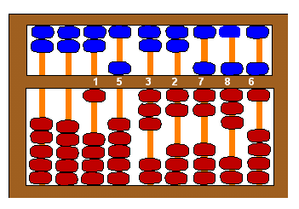
Decide how the data will be collected
Data collection
  Identify data sources
  Identify data collection method
  Share information
  Find the contact

Slide 45

Decide how the data will be collected
Data Sources
  Existing information
    Internal
    External
Research

Slide 46
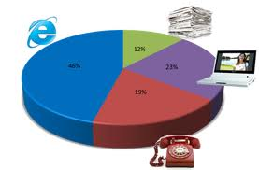
Decide how the data will be collected
Determine the Data Collection Method
  Indirect
    Visits as customer
    Purchase products
    Reverse engineering
    Survey competitor’s suppliers
  Direct
    Mail survey
    Telephone interviews
    Site visits

Slide 47

Collect the information
  How much better are they?
  Why are they better?
    Is their performance better?
    Are their practices/procedures better?
  How do they do what they do?
  What can we learn form them?
  How can we apply what we learned?

Slide 48

Analyze the Results
  Identify performance differences
  Identify reasons for the performance gap
    Process practices themselves
    Business practices
    Organizational structure
    Market
    Environment

Slide 49
Exercise: Benchmarking Step: discover the facts
  Review and analyze the following chart that compares data from three pharmacies with data from our own pharmacy.
  Develop a best in breed profile for these four pharmacies.
  What additional information would you like to have?
  Please file possible causes behind the performance gap.

Slide 50
Exercise: Benchmarking Step: discover the facts
 | Pharmacies
Characteristics | A | B | C | Us
Customers’
Satisfaction | 80% | 65% | 95% | 75%
Average wait | 15 min | 14 min | 15 min | 18 min
Operating Cost
Purchasing | $0.15 | $0.50 | $0.20 | $0.40
Warehousing | $1.00 | $0.75 | $1.25 | $1.05
Filling | $3.00 | $2.50 | $3.25 | $2.40
Refilling | $3.25 | $2.00 | $2.00 | $3.50
Information | $0.30 | $0.60 | $0.20 | $0.45
Total Operating | $4.55 | $4.15 | $4.40 | $4.75
Medication Costs per fill* | $20.00 | $22.00 | $19.00 | $23.00
*The higher this figure, the more positive results for the pharmacy.

Slide 51
Pitfalls of step 2: Discover Facts
  Picking the wrong benchmarks
    Poor performers
    Limited to domestic benchmarks
  Being too focused on inappropriate numbers
  Politics become intense
  People become defensive

Slide 52
Four Steps of Benchmarking
MONITOR AND RECALIBRATE
TAKE ACTION
DISCOVER FACTS
PREPARE TO BENCHMARK

Slide 53
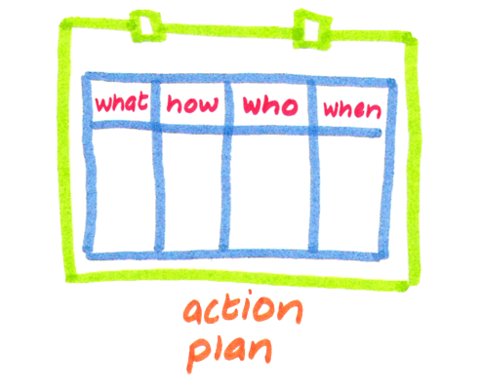
Step 3: Take Action
  Communicate results
  Establish goals
  Develop action plans
  Implement change

Slide 54
Step 3: Take Action
Overtaking the benchmark
Superior Performance
Gap
Your company / function
Benchmark company / function
Present
Future
TIME

Slide 55

Step 3: Take Action
New performance goals are based on:
  Where you are now
  Where the benchmark is now
  Where the benchmark will be at a chosen time in the future
  Where you want your organization’s performance to be

Slide 56
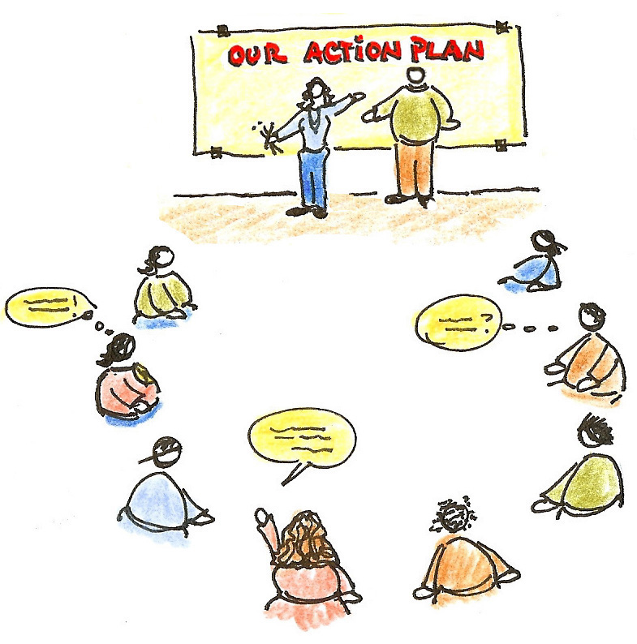
Step 3: Take Action
Develop action plans
  Based on the reasons for the performance gap and/or enablers discovered in the benchmarking study
  Compare action plans to strategic business plans
  Strategic, measurable goals and objectives are incorporated into the action plan.
  Goals must be communicated throughout the company

Slide 57
Exercise: Action Planning
  Given the causes you previously developed for the performance gap between the benchmark organization and our pharmacy, develop an action plan to help our pharmacy close the gap and become the benchmark company. Your action plans should include what should be done to:
  Increase customer satisfaction
  Lower operating costs
  Raise medication costs per fill

Slide 58
Pitfalls for Step 3: Take Action
  Goals are unrealistic
  Goals are not integrated into business or operations plans
  Forget to “soften the beaches” regarding findings

Slide 59
Four Steps of Benchmarking
MONITOR AND RECALIBRATE
TAKE ACTION
DISCOVER FACTS
PREPARE TO BENCHMARK

Slide 60
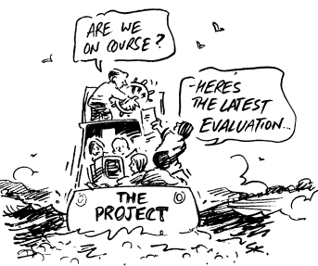
Step 4: Monitor and Recalibrate
  Monitor progress of benchmarking efforts in general and benchmarking projects in particular
  Update benchmarks at predetermined. milestones to determine progress made by both the benchmark and your own organization.
  Report progress in achieving targets to all employees on an ongoing basis.

Slide 61

Step 4: Monitor and Recalibrate
Monitor Benchmarking Project
  Were measurement identified?
  Were the benchmarking result communicated?
  Was there senior management “buy-in”?
  Was an action plan designed and implemented?

Slide 62
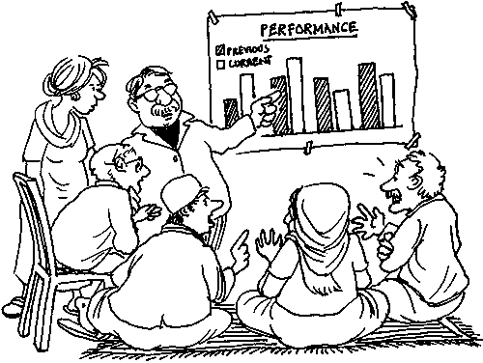
Step 4: Monitor and Recalibrate
Update benchmarks
  Has the benchmark changed?
  Has the best competitor/function changed?
  What is you progress? Have you met your goals?
  Have the benchmark companies improved? Should you adjust your goals?
  Are there emerging best practice companies?

Slide 63

Role of Management
  Set benchmarking goals
  Integrate into strategic plan
  Be a role model
  Establish environment for change
  Build infrastructure
  Monitor progress

Slide 64

Set goals and integrate
  Integrate into business strategy
  Set benchmarking direction
  Communicate benchmarking findings

Slide 65

Integration
  Do organizational goals incorporate benchmarking findings?
  Have benchmarking findings been integrated into the goals of each division and functional area?

Slide 66
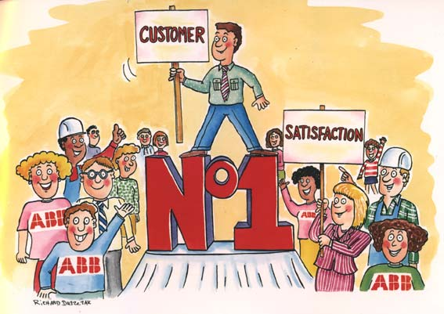

Strategic Benchmarking Focus
  Customer Satisfaction
  Human resource utilization
  Asset management
  Cycle time

Slide 67
Be A Role Model
  Be committed – senior managers must understand, commit to, and actively support benchmarking
  Be involved – to assure that the benchmarking team is
    Working on areas that are critical to the company
    Staying focused and
    Not experiencing insurmountable obstacles

Slide 68

Senior Management Response
  Let’s do it Prognosis: success
  Let’s not do it Prognosis: on hold
  Let’s do it (but Prognosis: failure
  never do)

Slide 69

Establish Environment for Change
  Show willingness to learn – if we do not use benchmarking findings to make changes, then benchmarking studies are a futile exercise
  Create trust – must maintain fundamental belief in the benefits of a benchmarking system.
  Demonstrate willingness to make change

Slide 70


Build the Infrastructure
  Provide rewards and recognition
  Devote the resources
  Provide training

Slide 71

Monitor Progress
  Business and operations reviews
  Benchmarking team reviews
  Company-wide benchmarking initiative

Slide 72
Operations and Business Review
  Where is your operation’s current performance compared to the benchmark?
  What are your plans to fill the gaps?
  What is the time frame to accomplish this?
  How do your investment strategies relate?

Slide 73
Benchmarking Team Review
  Who are your benchmarking partners?
  Why these companies?
  What have you learned?
  How have you used this intelligence to help set new performance goals?
  What are your recommendations?

Slide 74

Senior Management Task
  Provide leadership in planning and organizing
  Agree on the partnership companies
  Agree on the data collection methods
  Pick team members
  Remove obstacles to benchmarking

Slide 75
Senior Management Task (cont’d)
  Communicate and utilize findings
  Re-calibrate periodically
  Integrate with strategic quantity planning and TQM
  Publicize successful benchmarking examples
  Revise the reward system

Slide 76
Exercise: Benchmarking Obstacle
  List actions that senior management might inadvertently do that may derail the benchmarking initiative.

Slide 77

ACTION PLANNING

Slide 78
Benchmarking Action Plan: Getting Started
  Step: Review Strategic Quality Plans to identify benchmarking opportunities.
Action | Who is responsible | Resources Required | When completed
1.
2.
3.

Slide 79
Benchmarking Action Plan: Getting Started
  Step: Build the infrastructure that supports benchmarking including recognition and reward systems, training, organization, and budget.
Action | Who is responsible | Resources Required | When completed
1.
2.
3.

Slide 80
Benchmarking Action Plan: Getting Started
  Step: Assemble and charge the first benchmarking team.
Action | Who is responsible | Resources Required | When completed
1.
2.
3.

Slide 81
Benchmarking Action Plan: Getting Started
  Step: Provide in-depth training for the benchmarking team.
Action | Who is responsible | Resources Required | When completed
1.
2.
3.

Slide 82
Benchmarking Action Plan: Getting Started
  Step: Establish a process for monitoring benchmarking project progress and overall benchmarking initiative.
Action | Who is responsible | Resources Required | When completed
1.
2.
3.

Slide 83
Benchmarking Action Plan: Getting Started
  Step: Develop and communication strategy to announce commencement of benchmarking initiative and progress of benchmarking projects.
Action | Who is responsible | Resources Required | When completed
1.
2.
3.

Slide 84
Implementation
  Phases of Benchmarking Implementation
Getting Started
Ongoing Implementation
Sustaining the Effort

Slide 85

Implementation
  Senior management “buy-in” and training
  Pilot project
  Choose high-impact project
  Study lessons learned

Slide 86
Project Criteria
  High payback
  High visibility
  Measurable
  Short-term results
  High profitability of success
  Customer satisfaction issue

Slide 87
Ongoing implementation
  Organization – must be re-examined prior implementation in order to assess whether the existing structure and resources will support the benchmarking activity.
  Elements of the organization to examine include:
    Organizational self-assessment conducted to establish baseline performance
    Linkages to TQM processes clearly established
    Linkages to strategic quality planning defined

Slide 88
Ongoing implementation
  Elements of the organization to examine include (cont’d):
    Skilled education and training resources available to teach benchmarking skills
    Cross-functional benchmarking teams of appropriate line managers appointed and trained
    Empowered employees exist to implement changes resulting from benchmarking recommendations

Slide 89
Ongoing implementation
  Support systems – some of the systems that are critical to benchmarking’s success include:
    Prior adoption of TQM is a prerequisite condition for the introduction of benchmarking
    Data base of external industry, competition, and best practice companies created
    Critical metrics identified, measurement techniques implemented, and findings documented.

Slide 90
Ongoing implementation
  Support systems – some of the systems that are critical to benchmarking’s success include (cont’d):
    Researcher and financial analyst recruited to serve as ad hoc members of benchmarking teams
    Time, team, and budget devoted to the benchmarking project
    Customer-supplier partnerships developed through introduction of model-supplier and model-customer

Slide 91
Ongoing implementation
  Support systems – some of the systems that are critical to benchmarking’s success include (cont’d):
    Reward and recognition systems revised to support benchmarking team efforts.
    Ongoing recalibration of benchmarks to assess progress towards benchmarks and possible introduction of new benchmarks companies

Slide 92
Ongoing implementation
  Role Model Management – senior management is responsible for implementing benchmarking within the organization. Senior management must:
    Understand benchmarking
      reviews and accepts benchmarking findings and results
      Recognizes the benefits of benchmarking to the organization
      Commits to achieving the benchmarks

Slide 93
Ongoing implementation
  Senior management must (cont’d):
    Support benchmarking
      Personal actions reinforce benchmarking; makes needed changes in own behavior
      Trust and openness evident in management style
      Asks about benchmarking data at every operations review
    Use benchmarking
      Personally involved in conducting benchmarking of strategic issues
      Integrates benchmarking into TQM and strategic quality planning

Slide 94
Ongoing implementation
  Strategic Quality Planning – senior mgt. must integrate benchmarking findings into strategic quality planning.
    The benchmarking vision that is developed from wanting to leapfrog over other companies must be linked to the vision that is developed as part of the strategic quality planning process.
    Customer satisfaction is the guiding principle for everything the company does.
    Benchmarks become inherent in strategies and goals.

Slide 95
Ongoing implementation
  Strategic Quality Planning (cont’d)
    Model-supplier and model-customer concepts are developed and integrated into company direction.
    Implementation of plans are developed for all major divisions and cascaded throughout the organization.

Slide 96
Ongoing implementation
  Communication and training – key elements that will help bring about the desired changes required to successfully implement benchmarking. Elements of the communication plan include:
    Develop communication plan to roll out benchmarking program
      Communicate benchmarking findings
      Communicate benchmarking recommendations and results

Slide 97
Ongoing implementation
    Develop communication plan to roll out benchmarking program (cont’d)
      Recognize benchmarking team successes
      Spread news about the relationship with customers and suppliers
      Obtain acceptance and “buy-in” from all levels of employees

Slide 98
Ongoing implementation
  Communication and training – Senior management must receive a briefing on benchmarking:
    Understand benefits to the organization
    Overview of the process
    Role of management
    Relationship to TQM and strategic quality planning
    Implementation planning

Slide 99
Ongoing implementation
  Communication and training – Benchmarking team must acquire the skills to conduct benchmarking studies:
    Prepare for implementation of benchmarking
    Develop capability and skills

Slide 100

Sustaining the Effort
  Critical success factors
    Benchmarking requires…
    …a commitment management
    …willingness to learn and adapt ideas of others
    …a bedrock of total quality management
    …that results must be integrated with strategic quality plans
    …an organization capable of change

Slide 101
Sustaining the Effort
  Critical success factors
    Benchmarking…
    …is a two-way communication process
    …efforts must be rewarded and recognized
    …teams represent those responsible for implementing recommendations
    …must begin with an assessment of own operations
    …subjects chosen must be critical for organization’s success

Slide 102
Exercise: Implementation Barriers
  What are the potential barriers to implementing benchmarking?
  How can these barriers be overcome?

